Slide 1
Raccoony
Team Members:
Bogdan TATU
Raul SARBU

Slide 2

Raccoony is a game browsing application.
Why?
Interesting concept
Learning opportunity
Teamwork experience
Git/Jira real applications
Improve Java proficiency

Slide 3
Project Overview
1
Let’s check our Use Case diagram.

Slide 4
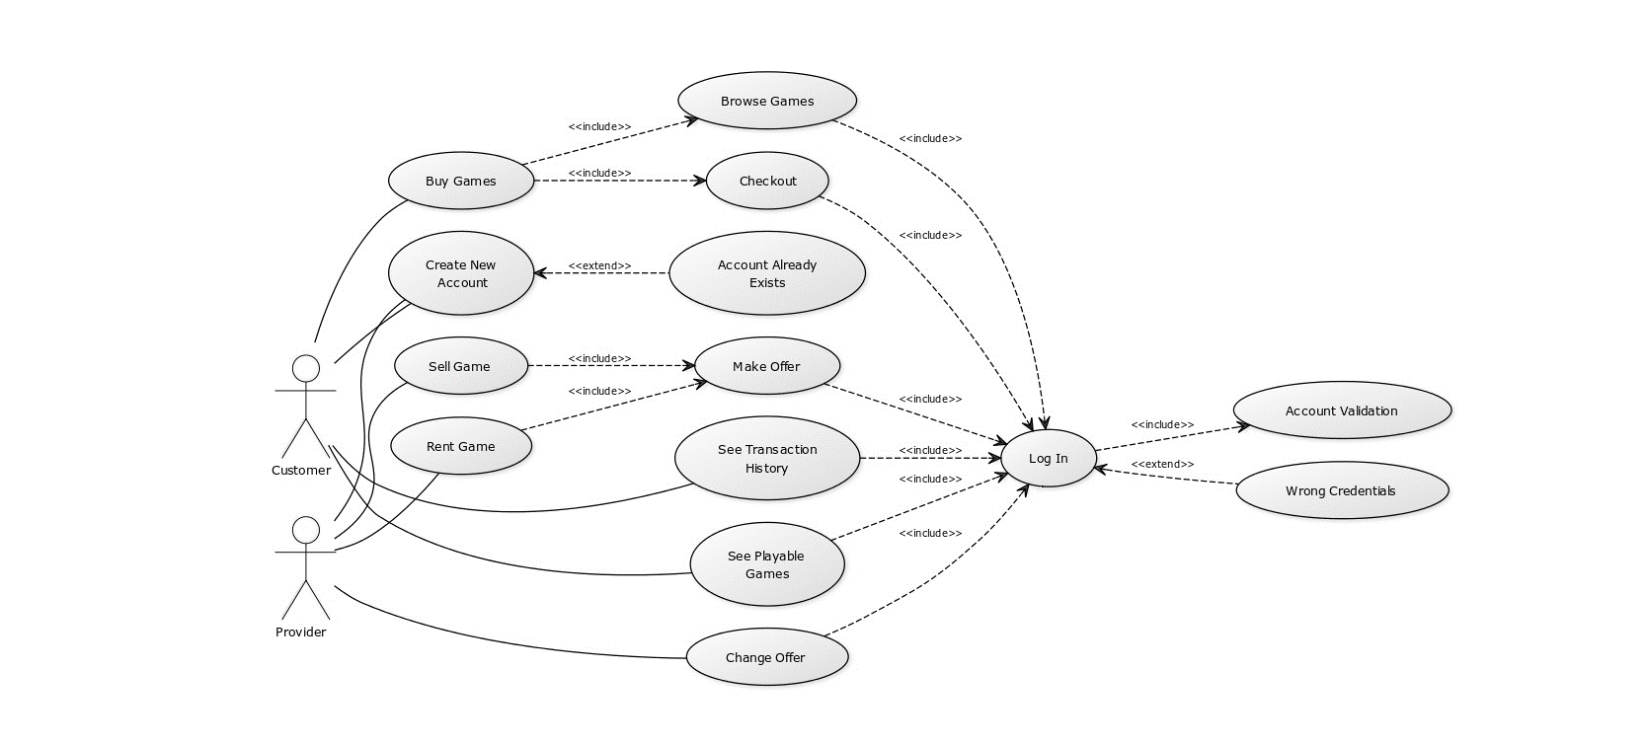

Slide 5
General work performed by team members
Raul
General classes
GUIs & overall theme
Data management
Bogdan
Account functionalities
Databases
Stage transitions

Slide 6
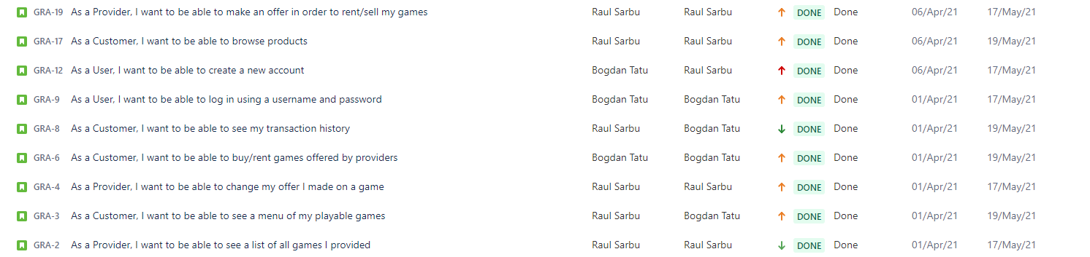
Stories overview

Slide 7
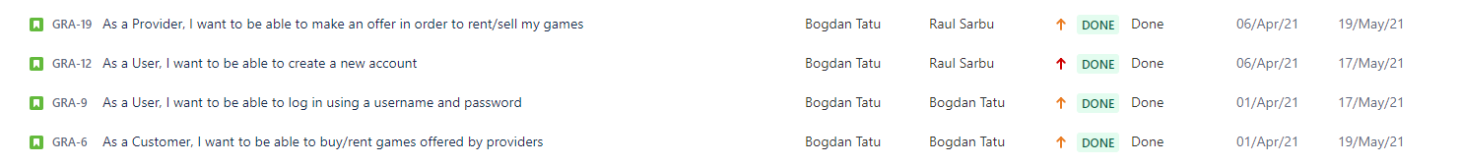
Bogdan TATU’s stories

Slide 8
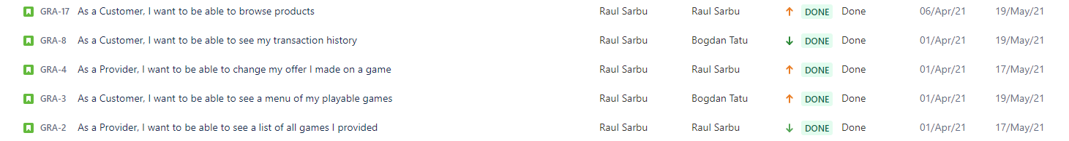
Raul SARBU’s stories

Slide 9

GitHub
Teamwork

Slide 10
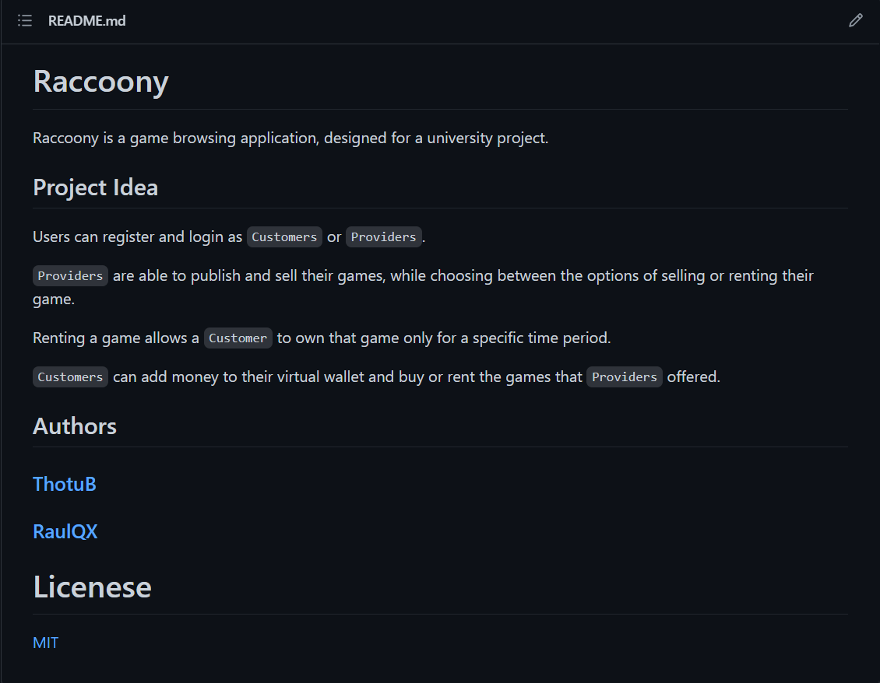

Slide 11
Contributions
104 commits
157 total files
4707additions & 958 deletions

Slide 12
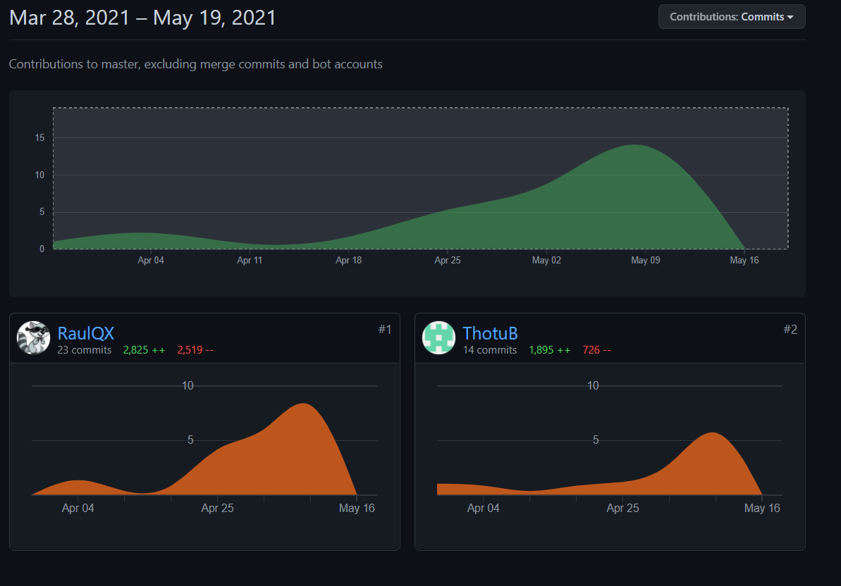
Contributions

Slide 13
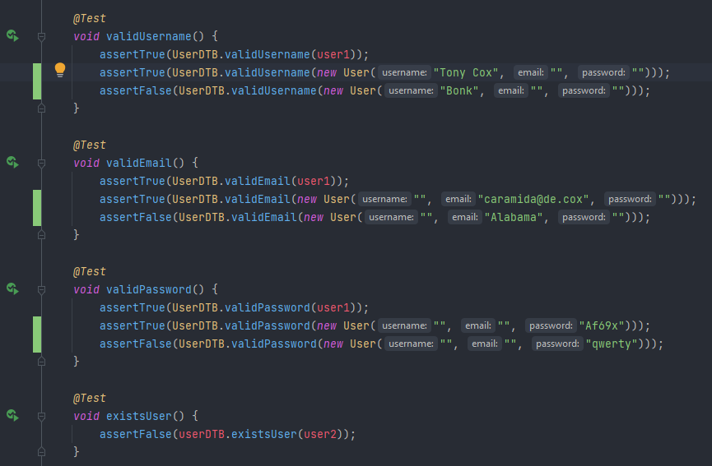
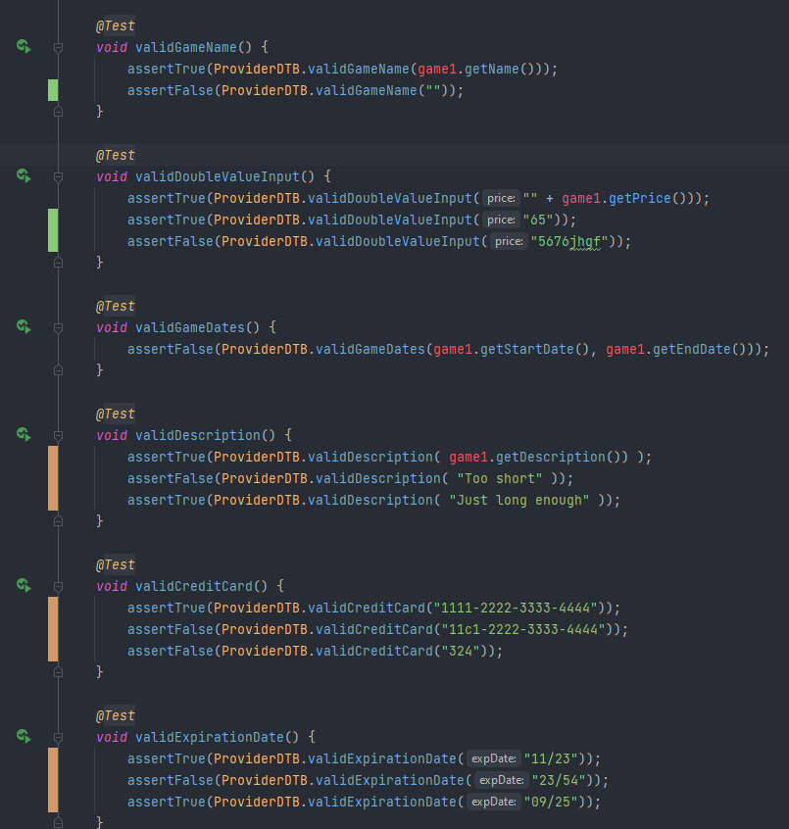
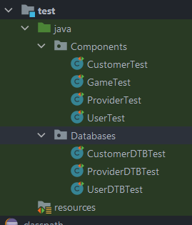
Testing Overview
Component testing
Database testing
Controller testing done separately

Slide 14
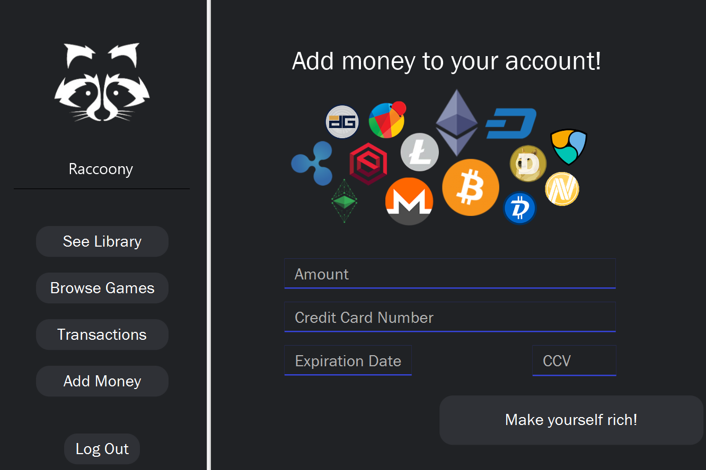
Sneak peak

Slide 15
Thank you for your attention!
Any questions?

